Slide 1
ESCI Day Cyprus
25 September 2025, Nicosia
University of Cyprus
Victor Aguilar, Policy officer
European Commission, DG EAC
ESCI Team, Unit B1 – Higher education

Slide 2

The European Student Card Initiative (ESCI)
Flagship initiative to make the European Education Area more inclusive, digital and interconnected.
Facilitates digital exchanges among higher education institutions (HEIs), simplifies student mobility and builds a shared European identity for higher education students.
All ECHE holders and HEIs participating in a European Universities alliance, commit to implementing the ESCI.
The Council Recommendations on building bridges for effective European higher education cooperation (5 April 2022) and Europe on the Move – learning mobility opportunities for everyone (13 May 2024), call on Member States to support and widen ESCI implementation.

Slide 3

European Student Card Initiative
Erasmus Without Paper
European Student Card
Erasmus+
App
Notes:
How to use the speaker slide? Just that if you want to put a picture, you should click on it and then choose "Replace image"

Slide 4



ESCI is driving change across the European Education Area
Encouraging investments in digital infrastructure in higher education
Connecting higher education institutions
Enhancing students’ mobility experience
This is how ESCI is building a Europe fit for the Digital Age

Slide 5
Erasmus Without Paper (EWP) overview

Slide 6


EWP statistics
Over 3,200 higher education institutions (HEIs) connected across all Erasmus+ programme countries
  20 third-party providers
  38 in-house systems
  EWP Dashboard: EC-funded solution
2/3 of all ECHE holders exchange successfully on EWP.
Erasmus+ App backend connected to the EWP Dashboard and HOME module

Slide 7
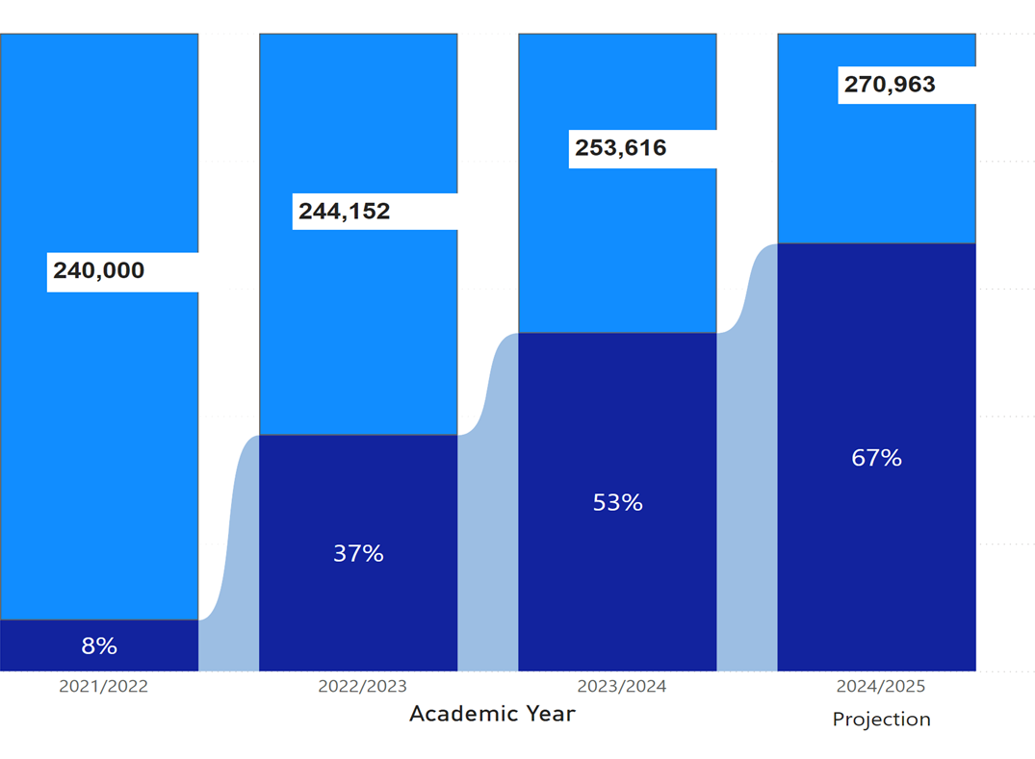
Steady growth in digital exchanges through EWP
There are close to 250,000 Erasmus+ outgoing student mobilities for studies every year.
Light blue: total number of outgoing student mobilities for studies (SMS) as reported in the Beneficiary Module (BM).
Dark blue: percentage of digital learning agreements (DLAs) signed through the EWP Network as reported in the EWP Stats Portal.

Slide 8
Inter-institutional agreements (IIAs) in EWP
1 January 2023
Total in the network: 184.907
Total mutually approved: 50.162
Approval rate: 27%
1 January 2024
Total in the network: 377.697
Total mutually approved: 152.253
Approval rate: 40%
1 February 2025
Total in the network: 542.746
Total mutually approved: 233.828
Approval rate: 43%
1 September 2025
Approval rate: 45%
Total in the network: 589.795
Total mutually approved: 266.805

Slide 9

Cyprus snapshot – EWP
  40 ECHE holders (as of 22 Aug 2025)
  34 institutions are connected to the EWP Network and exchanging
  2 institutions are connected to the EWP Network but are not exchanging
  4 institutions are not connected to the EWP Network
  System used: 1: EWP Dashboard
Source: EWP Stats Portal, Sep 2025

Slide 10
2024 EWP digitalisation rate in Cyprus:
 | Digitalisation level
High | 70%-100%
Medium | 25%-69%
Low | 1%-24%
Not using EWP | 0%

Slide 11
Top HEIs in Cyprus by outgoing student mobility
Higher education institution | System used | Number of outgoing students in BM (2022-2023)* | Total DLAs completed (2023-2024)* | Digitalisation rate 2024 | Digitalisation rate 2023 | Trend
University Of Cyprus | EWP Dashboard | 182 | 209 | 100%* | 100% | ↑
European University Cyprus | EWP Dashboard | 36 | 24 | 67% | 100% | ↓
Edex - Educational Excellence Corporation Limited | EWP Dashboard | 27 | 51 | 100%* | 94% | ↑
Technologiko Panepistimio Kyprou | EWP Dashboard | 12 | 21 | 100%* | 91% | ↑
Neapolis University | EWP Dashboard | 9 | 4 | 44% | 100% | ↓
Frederick University | EWP Dashboard | 8 | 20 | 100%* | 100% | ↑
Anoikto Panepistimio Kyprou (Open University Of Cyprus) | EWP Dashboard | 4 | 8 | 100%* | 50% | ↑
Chrysako Educational Centre Limited (College Of Tourism And Hotel Management) | EWP Dashboard | 3 | 4 | 100%* | 50% | ↑
Uclan Cyprus Limited | EWP Dashboard | 3 | 3 | 100% | 60% | ↑
G. Takkas Educational College | EWP Dashboard | 2 | 3 | 100%* | 100% | →
Theologiki Sxoli Ekklisias Kyprou | EWP Dashboard | 1 | 6 | 100%* | 100% | ↑
* The number of DLAs completed and the number of outgoing students is not a perfect match due to differences in the academic years compared (BM: 2022-2023 and EWP: 2023-2024) and overall yearly increases in mobilities.

Slide 12

Main findings
Cyprus maintained 100% digitalisation rate at the national level in 2024 – in alignment with the European Commission’s 95% digitalisation target.
Projections for the ongoing academic year (2024-2025) indicate that Cyprus will maintain this rate in the next exercise (2025).
The EWP Dashboard is predominantly used by Cypriot HEIs.
Cyprus’ 100% digitalisation reflects aggregated data. At the institutional level, digitalisation rates may vary.
While some institutions exceed 100%, this surplus compensates for lower digitalisation rates at others.
Declines in digitalisation rates at institutional level highlight the need for targeted support/outreach to sustain the positive adoption levels.

Slide 13
European Student Card (ESC) overview

Slide 14
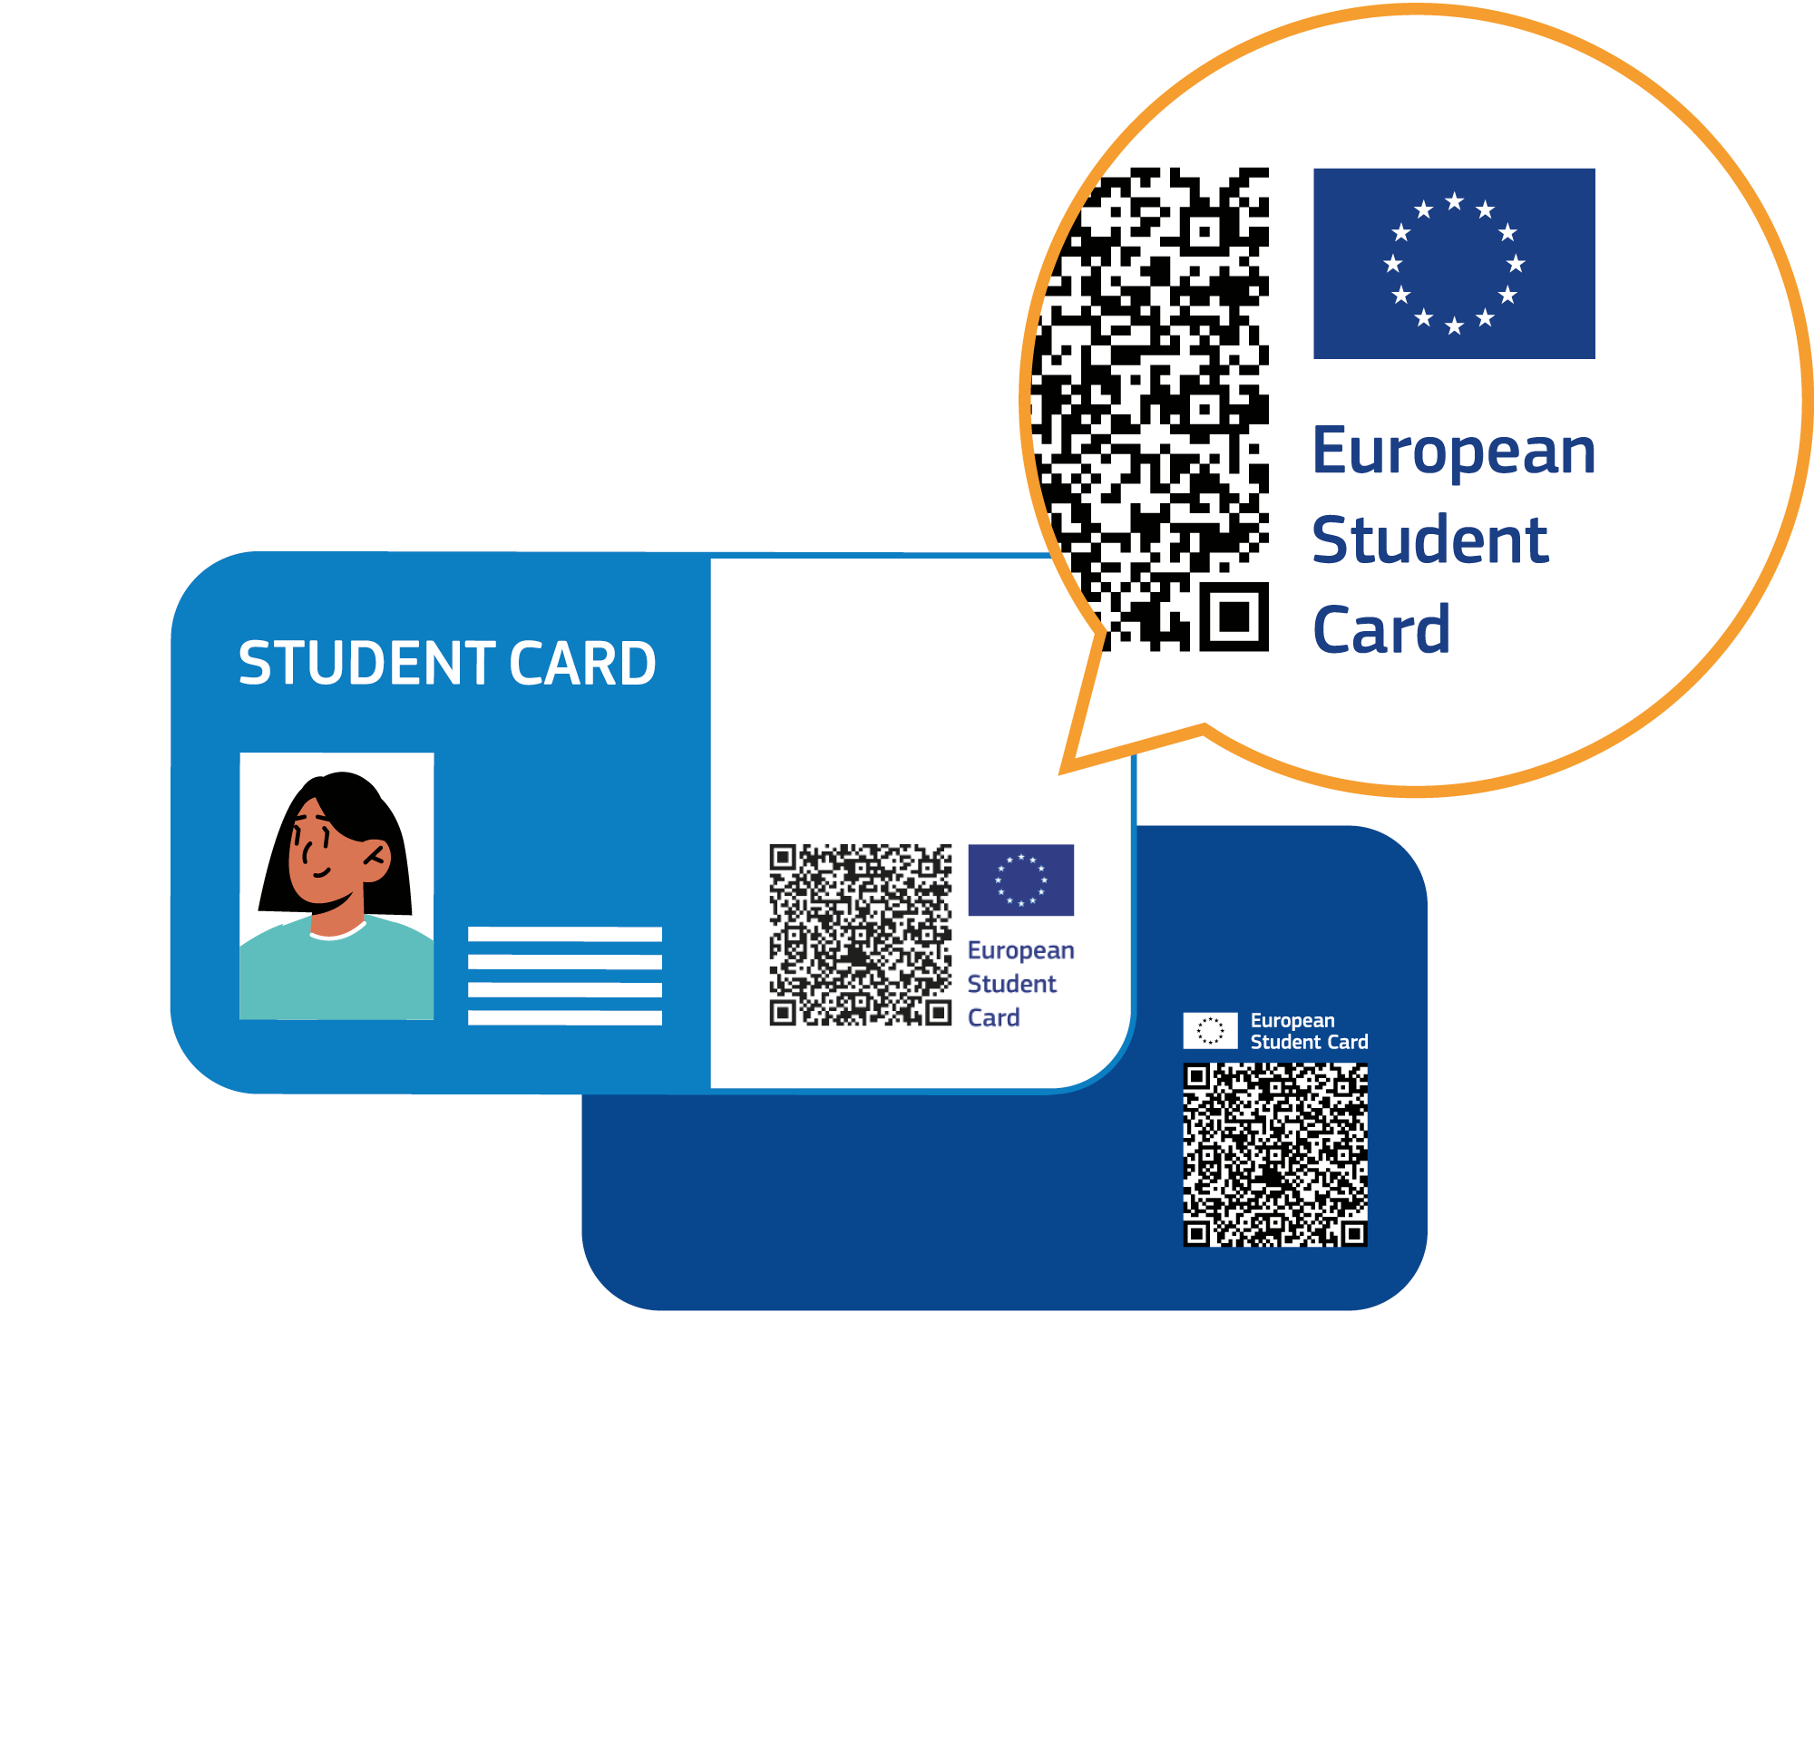
The European Student Card (ESC)
The ESC is not a new card. It’s higher education institutions’ current cards upgraded with a set of common visual and technical elements that HEIs can add via the ESC-Router.
The ESC can be adapted to digital and physical formats with any type of technology (e.g., chip technology, magnetic stripe, etc.).
European Student Identifier (ESI)
A digital identifier used to uniquely identify students of European higher education institutions, linking them to a given ESC
European Student Card logo
Integrates the EU flag with the text “European Student Card” and a QR code, certifying the card’s authenticity across Europe and enabling the validation of student status
European Student Card Number (ESCN)
A unique card identifier that serves to identify student cards belonging to a given institution and to validate them
14

Slide 15
The European Student Card (ESC)
The ESC adds a European dimension to existing higher education student cards so students can have their student status easily recognised across Europe.
Students
Higher education institutions
Student service providers
Simplified access to student services during mobility with their existing student card, just as local students (e.g., libraries, dormitories, discounts, etc.)
Shared European student identity
Securely validate the student card of incoming mobile students
Support reciprocity in service provision to mobile students.
Streamline the verification of student status
Gain access to a wider network of users
15

Slide 16



ESC state of play
4.0M
1.9M
Max
+32%*
+7%*
[0 to 100[
[100 to 200[
Total ESCs issued
Active ESCs
[200 to 300[
[300 to 400[
400+
400+
18
471
400+
400+
+20%*
Min
+52%*
400+
400+
Countries where ESCs are issued
Organisations that have issued ESCs
* Compared to Nov 2024, after the launch of the new ESC Router. Data extracted on 22 Sep 2025.
16

Slide 17
Cyprus snapshot – ESC
5
0
4
Organisations registered in the ESC-R
Organisations issuing ESCs*
Total ESCs issued in Cyprus
Max
[0 to 100[
[100 to 200[
[200 to 300[
* At least 10 active ESCs
[300 to 400[
400+
400+
400+
400+
Min
List of institutions in the ESC-Router
400+
400+
University of Cyprus
EIMF Holding Limited
University of Nicosia
Ledra College
Cyprus University of Technology
Data extracted on 22 September 2025
Notes:
28 Card issuers registered: FR: 20, FL: 6, DE: 1
HEIs to be removed:
Universite Saint-Louis - Bruxelles
ECOLE SUPERIEURE DES ARTS SAINT-LUC DE TOURNAI
Universite de Namur
VRIJE UNIVERSITEIT BRUSSEL
ECOLE IT
Haute Ecole Louvain en Hainaut - HELHa
Hogeschool Gent
Artevelde University of Applied Sciences
ARES AcadÃ©mie de recherche et d'enseignement supÃ©rieur
HAUTE ECOLE DE NAMUR-LIEGE-LUXEMBOURG has 4 active ESCs, but likely for testing purposes.
Other HEIs have issued 1-2 cards in the past:
Haute Ecole Bruxelles-Brabant (HE2B) (2)
Vlerick Business School (2)
KU Leuven (1)
Haute École Albert Jacquard (HEAJ) (1)

Slide 18
2024 ESC adoption rate in Cyprus
 | ESC adoption level
High | 70%-100%
Medium | 25%-69%
Low | 1%-24%
Not issuing active ESCs | 0%

Slide 19

Main insights
5 Cypriot HEIs are registered in the ESC-R (12.5% of all ECHE holders in Cyprus)
None is actively issuing ESCs. Two have issued 1-3 ESCs, likely for testing purposes.
It’s important to identify any obstacles that keep Cypriot HEIs from issuing ESCs – especially those institutions already connected to the ESC-R.
  The new ESC-R, hosted in the European Commission’s cloud, brings additional security, scalability and a better user experience.
  The new ESC logo is easier to implement and doesn’t require the purchasing of holograms, facilitating ESC adoption.
  The ESC Service Catalogue will allow HEIs and service providers to list the services they provide to ESC cardholders.
Photo by Júnior Ferreira on Unsplash

Slide 20
ESCI - Outlook until the end of the Erasmus+ programme

Slide 21

Guiding principles
Consolidation and improvement of existing processes.
Continuation of services and infrastructure at least until the end of the current programming period.
Stability and scale.
Building on current investments.
Based on thorough consultation of users and providers to establish future requirements.

Slide 22
European Student Card
Accelerate issuance of ESCs within and across all programme countries
Explore partnerships with key student services to bring added value to ESC holders
Launch of the ESC Service Catalogue
Increase rollout of digital European Student Cards

Slide 23
Erasmus Without Paper
Reach 95% digitalisation target of DLAs concluded in the EWP network
Introduction of nominations (beta testing) with a gradual roll out until the end of 2025
Review Transcript of Records modalities of deployment (2026 onwards)
Prepare future IIA renewal scenarios (ongoing consultation)
Acceptable use policy revision and implementation (2025)

Slide 24
ESCI Champions

Slide 25

ESCI Champions
Institutions that have made significant progress in implementing the European Student Card Initiative (ESCI) and commit to sharing best practices with their peers.
Builds and expands on the successful EWP Champions (2023-2025).
31 organisations (one per National Agency) across three categories
  Erasmus Without Paper (EWP)
  European Student Card (ESC)
  Champion of excellence (EWP + ESC)
Nominated by Digital Officers in each Erasmus+ National Agency
Cypriot ESCI Champion: University of Cyprus!

Slide 26

ESCI Champions kick-off meeting – Gothenburg (09 Sep 2025)

Slide 27
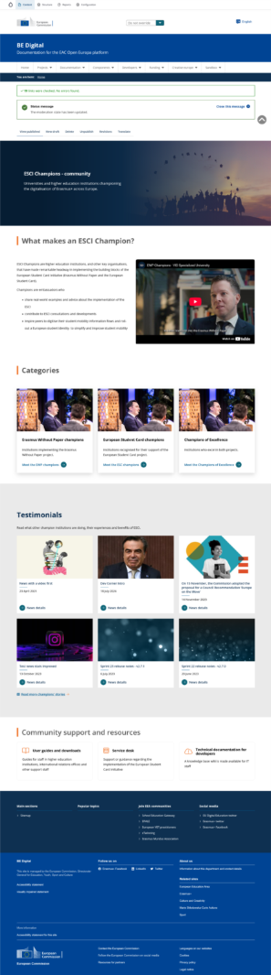
UPCOMING! ESCI Community Space
DRAFT
DRAFT
DRAFT

Slide 28
Useful resources

Slide 29

Support and useful resources – EWP
ESCI portal
ESCI service desk
ESCI bi-monthly newsletter
EWP Champions
EWP developers page
EWP User Groups
EWP User Guides
EWP governance reports
News and events
Notes:
Harpa

Slide 30

Useful resources ESC
ESC General specifications
ESC Technical specifications
ESC graphic charter
Video tutorial: how to access and manage ESCs in the ESC Router
ESC Service Desk
ESC partnerships programme
Photo by Laura Kapfer on Unsplash

Slide 31
Thank you!

