Slide 1
OLA for Beginners July 19th
Agenda
Learning Agreement – Emma Zeniou
Erasmus Dashboard – Efi Michael
EWP Competence Centre – Stavroula Antoniou
Q & As
Updates for consideration

Slide 2
EWP Competence Centre
https://wiki.uni-foundation.eu/display/EWP/
https://wiki.uni-foundation.eu/display/App/IROs+and+the+App

Slide 3
NEW! Service desk for HEIs
June- September 2021
Email based support embedded with the existing Helpdesk infrastructure
Tailor based advice to HEI

Slide 4
Proposed timeline for IT infrastructure preparedness
Notes:
Alex

Slide 5
Erasmus+ App state of play
Notes:
Oana

Slide 6
Find the promo toolkit online
hello.erasmusapp.eu

Slide 7
Second release event
21 September 2021 – Save the Date
Hybrid event focusing on the student and HEI perspectives
Dialogue between the Commissioner and students with focus on Programme priorities and the role of digitalisation

Slide 8
Inter-institutional agreements
Until the IIAs can be renewed digitally via the Erasmus Without Paper infrastructure and at the latest by the academic year 2022/2023, the existing bilateral IIAs from the Erasmus+ programme 2014-2020 may remain valid.
Exceptionally, HEIs may sign paper versions of IIAs for which a template has been provided (“Bilateral IIA”).
It is currently possible to sign a paper version for multilateral inter-institutional agreements (“Multilateral IIA”)
The international IIA is still under development but modeled on the intra-EU IIAs.
There is an option for the BIP partnership to be formalised through a multilateral inter-institutional agreement on paper.
Notes:
Nadia

Slide 9
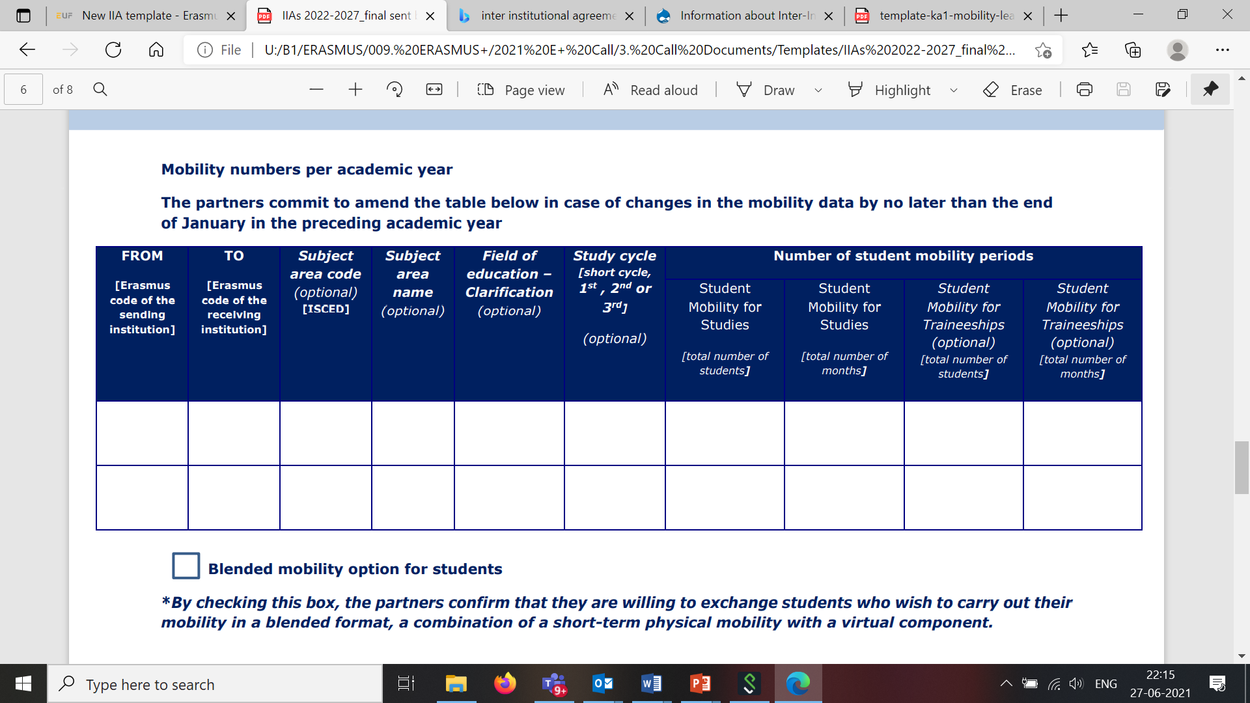
Blended mobility in digital IIA
Notes:
Nadia

Slide 10
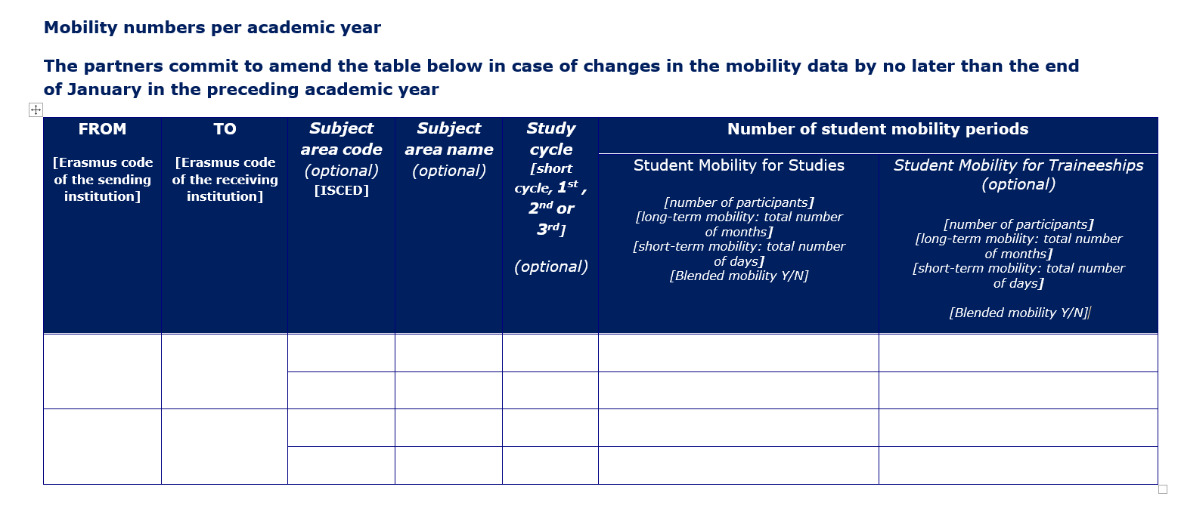
Alternative proposal for blended mobility in the future
Notes:
Nadia

Slide 11
Thank you!

