Slide 1
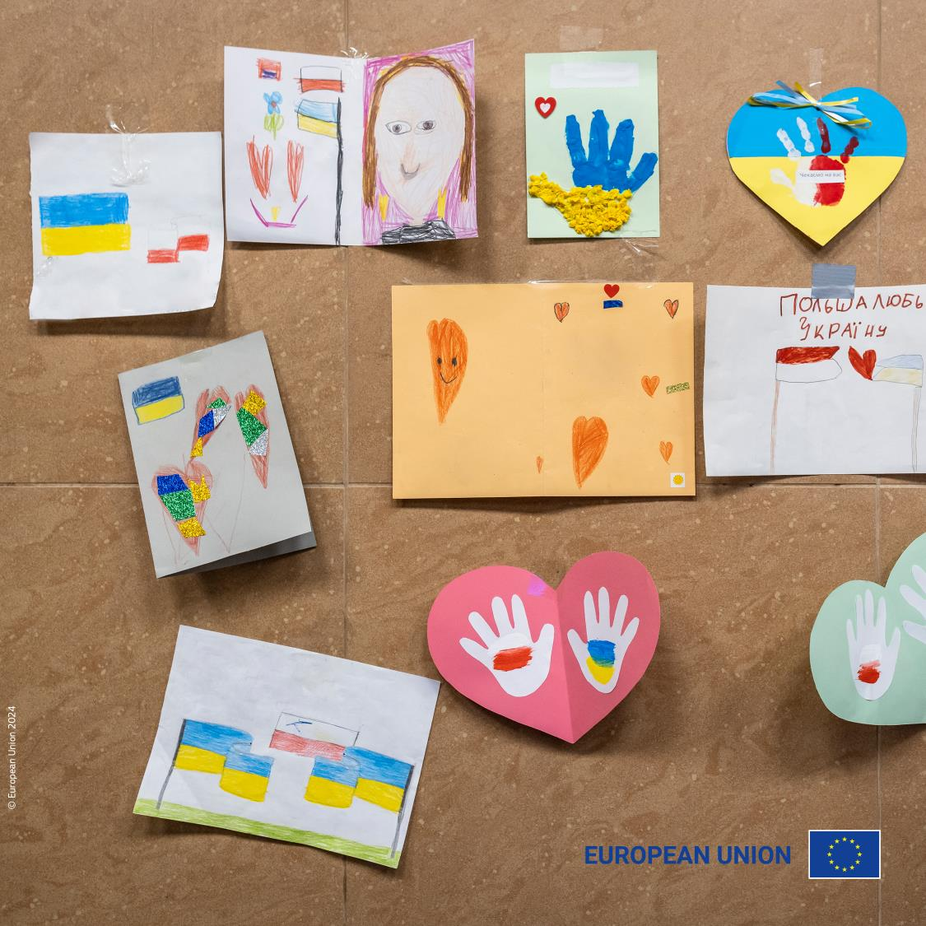
Building hope:
Europe’s solidarity with Ukraine
15 inspiring Erasmus+ and
European Solidarity Corps projects
providing support to people
affected by the war

Slide 2
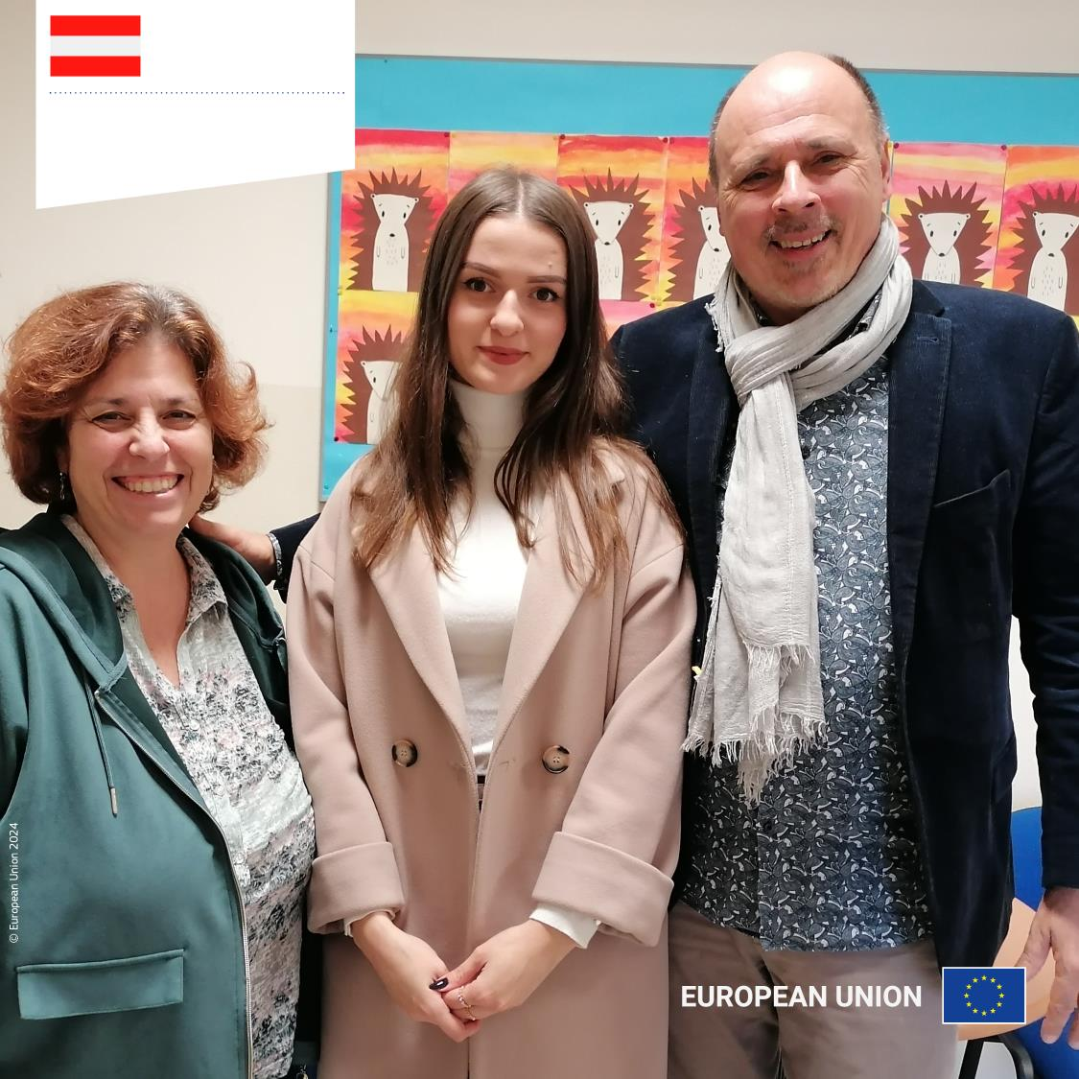
Austria
Bridging education and integration in Vienna
Ukraine-Crisis-Support of PH Wien

Slide 3
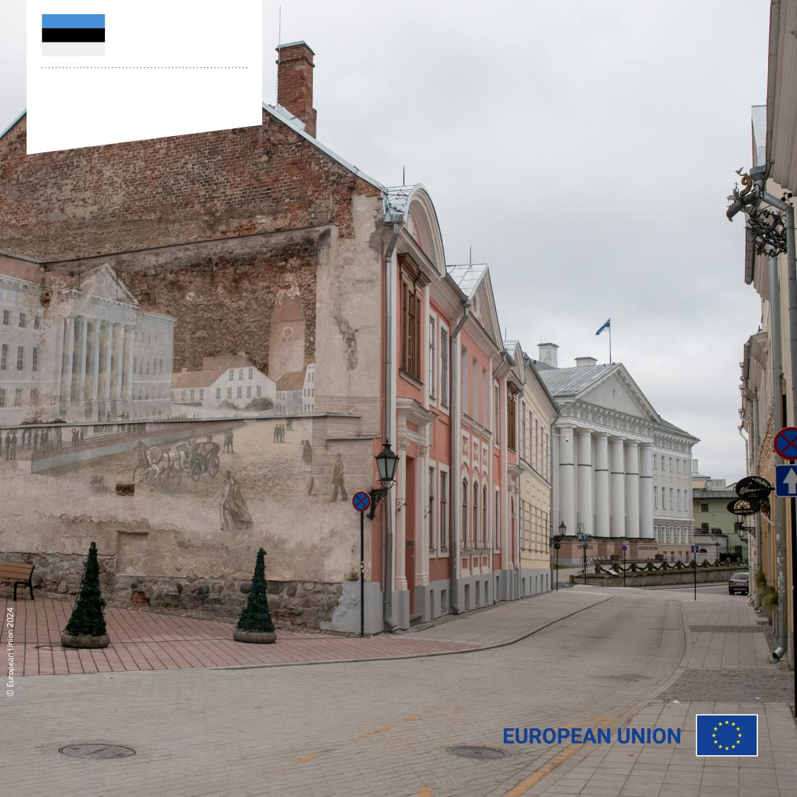
Estonia
Learning Mobility of Individuals
Enabling medical students to complete their studies

Slide 4
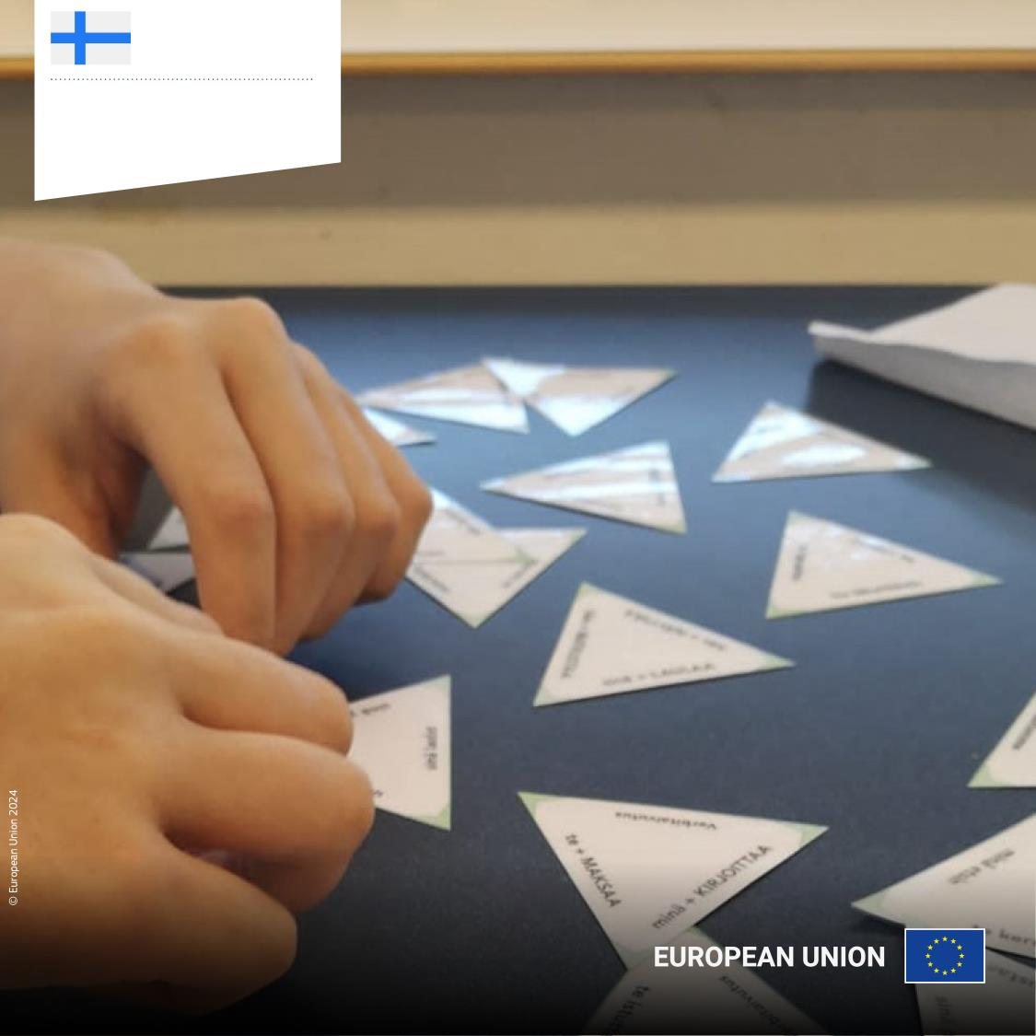
Finland
Fostering Ukrainian-Finnish connections
Responsible Future Learners

Slide 5
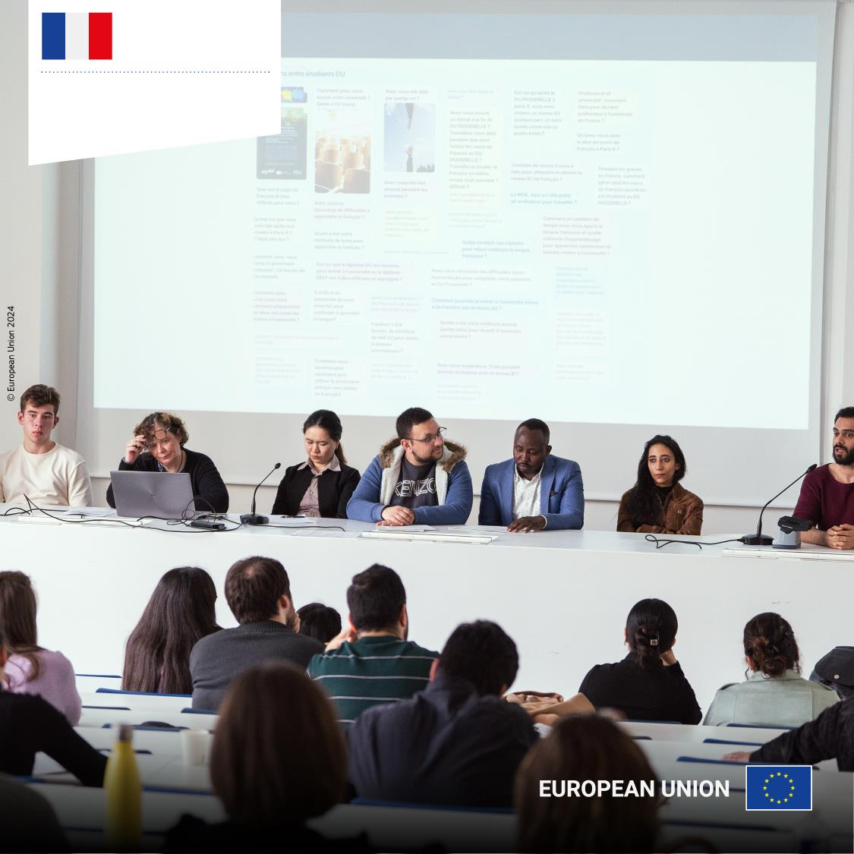
France
Building inclusive higher education systems
AGILE - Higher education resilience in refugee crises

Slide 6
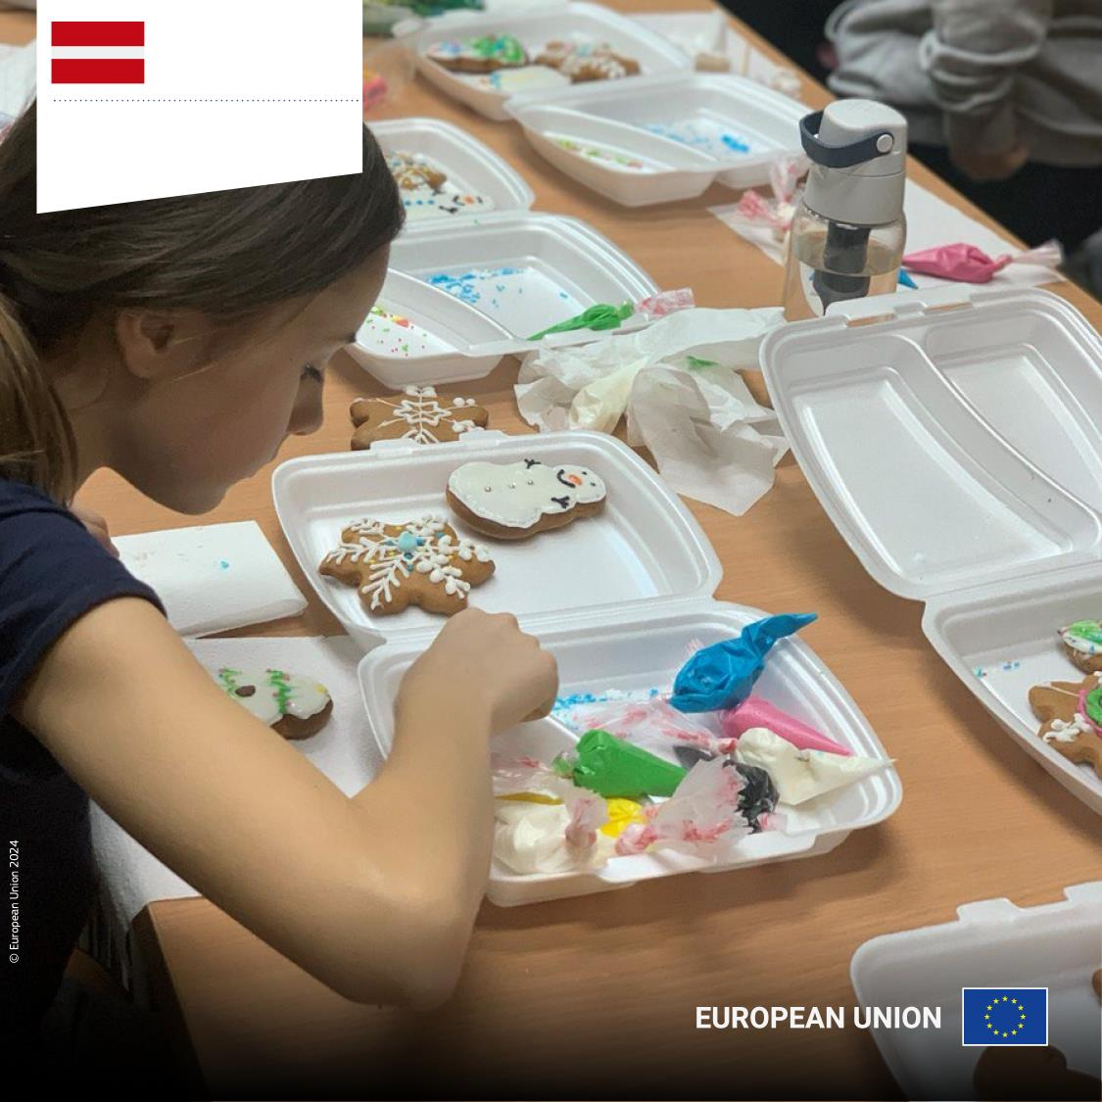
Latvia
Promoting integration and breaking stereotypes
United in Culture
Welcoming Ukrainian refugees

Slide 7
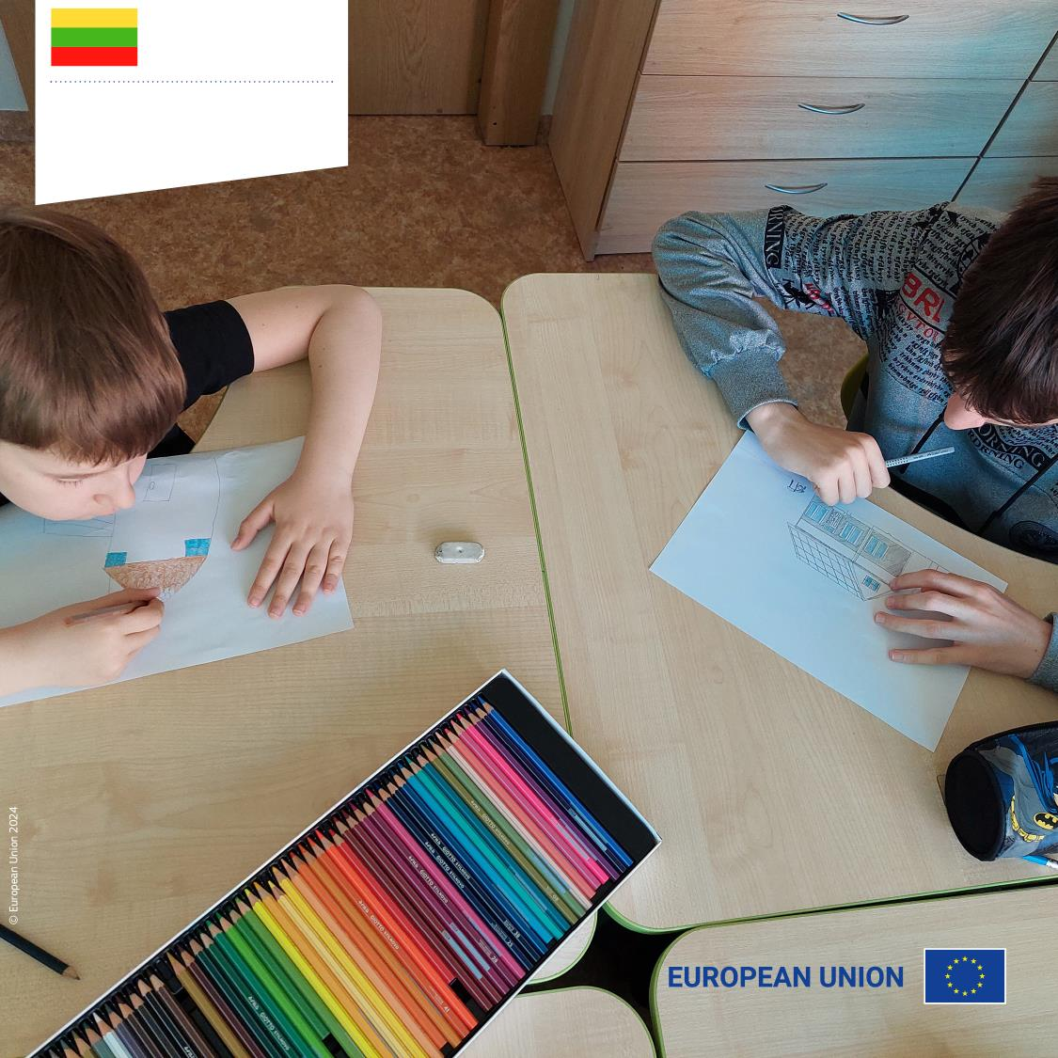
Lithuania
Enriching learning for students with special educational needs
Special education students overcome obstacles with art therapy

Slide 8
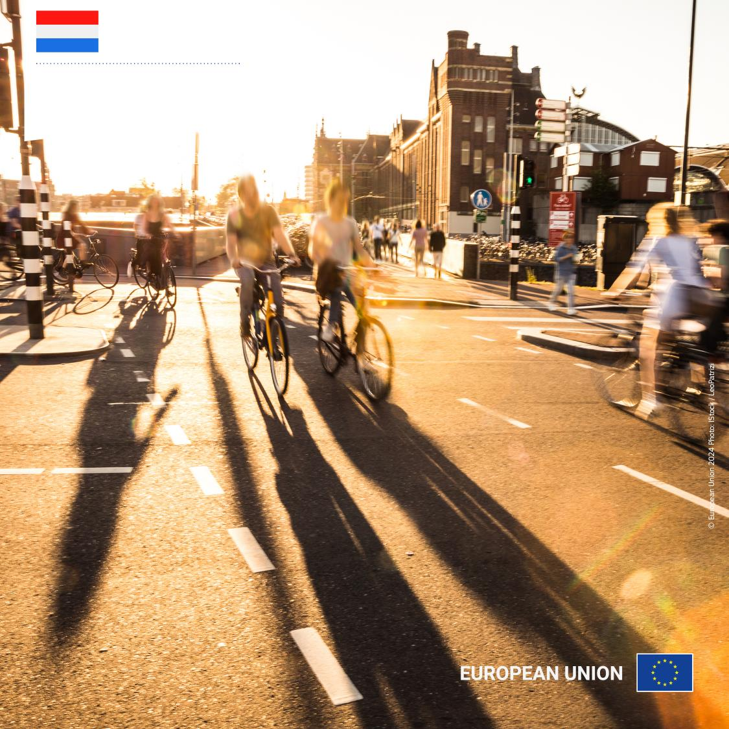
The Netherlands
Learning Mobility of Individuals
Expanding opportunities with a second Erasmus+ period

Slide 9
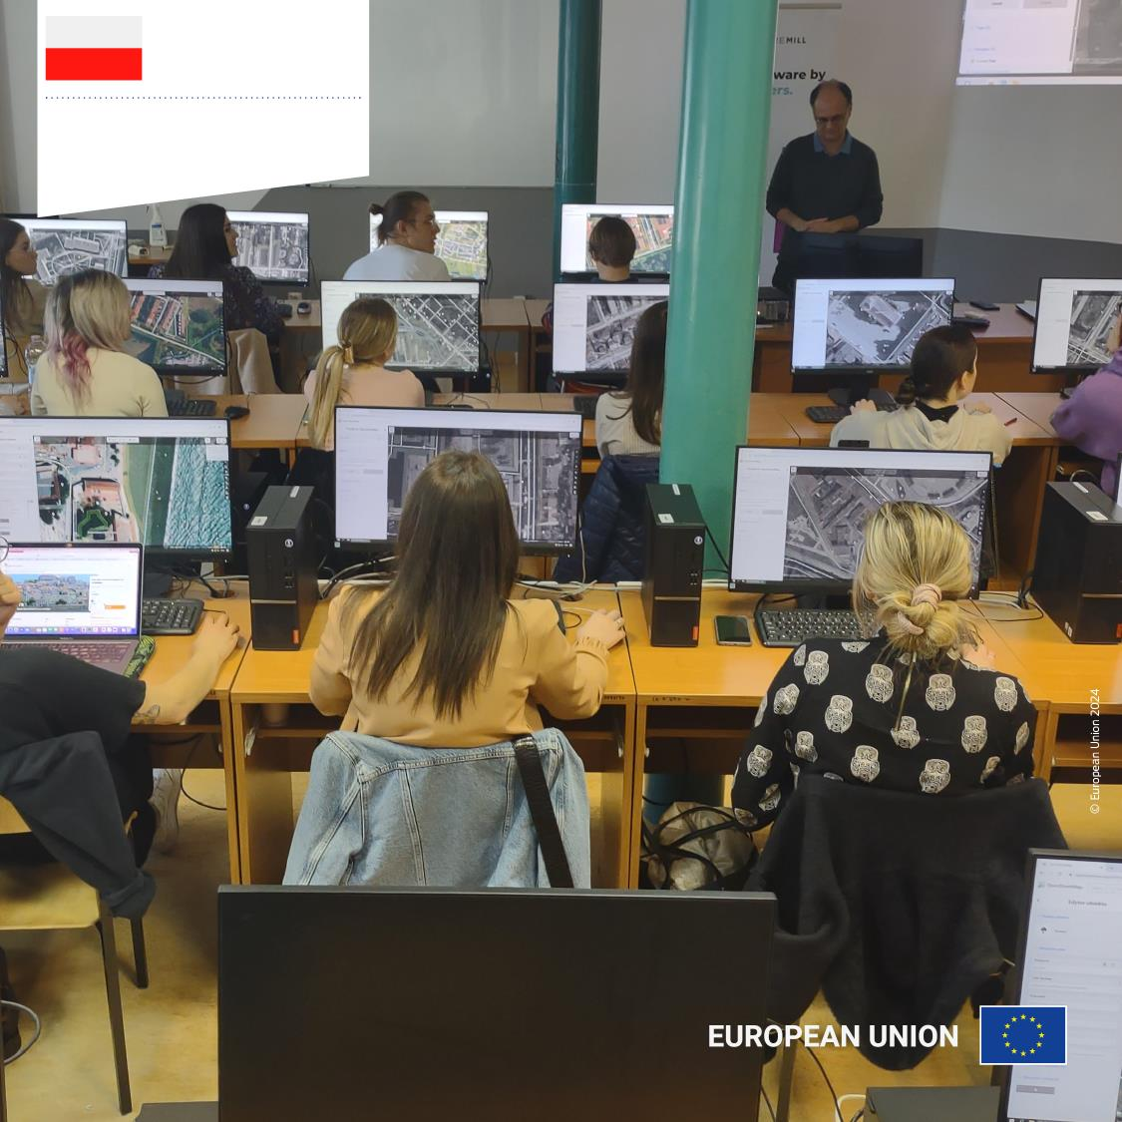
Poland
Exploring territorial capacity for refugee accommodation
Sustainable Spatial Planning of Tourism Destinations

Slide 10
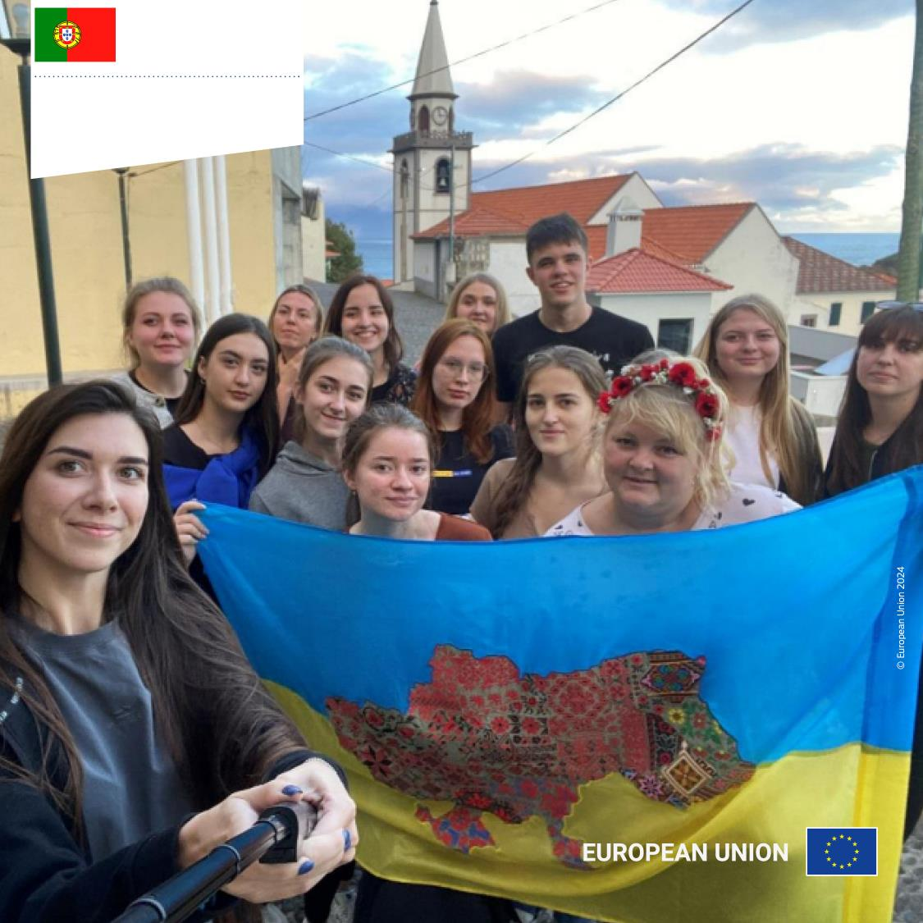
Portugal
Building critical thinkers through a media literacy project
Youth Media Sharks

Slide 11
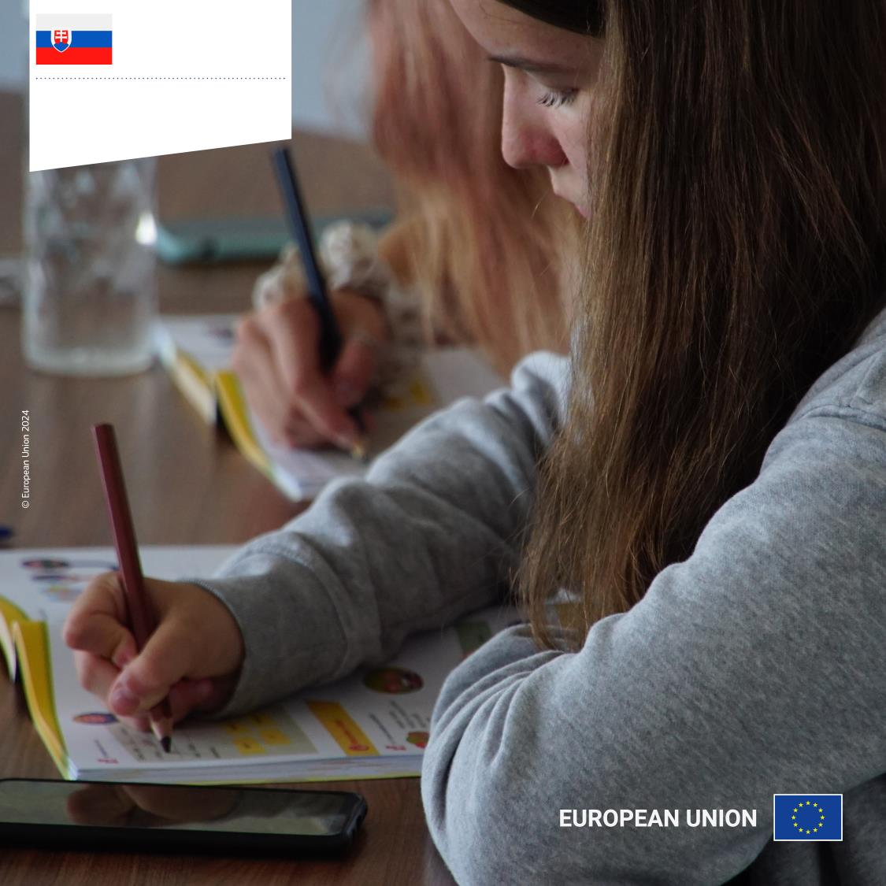
Slovakia
Boosting integration through Slovak language learning
Slovak for Children of Foreigners

Slide 12
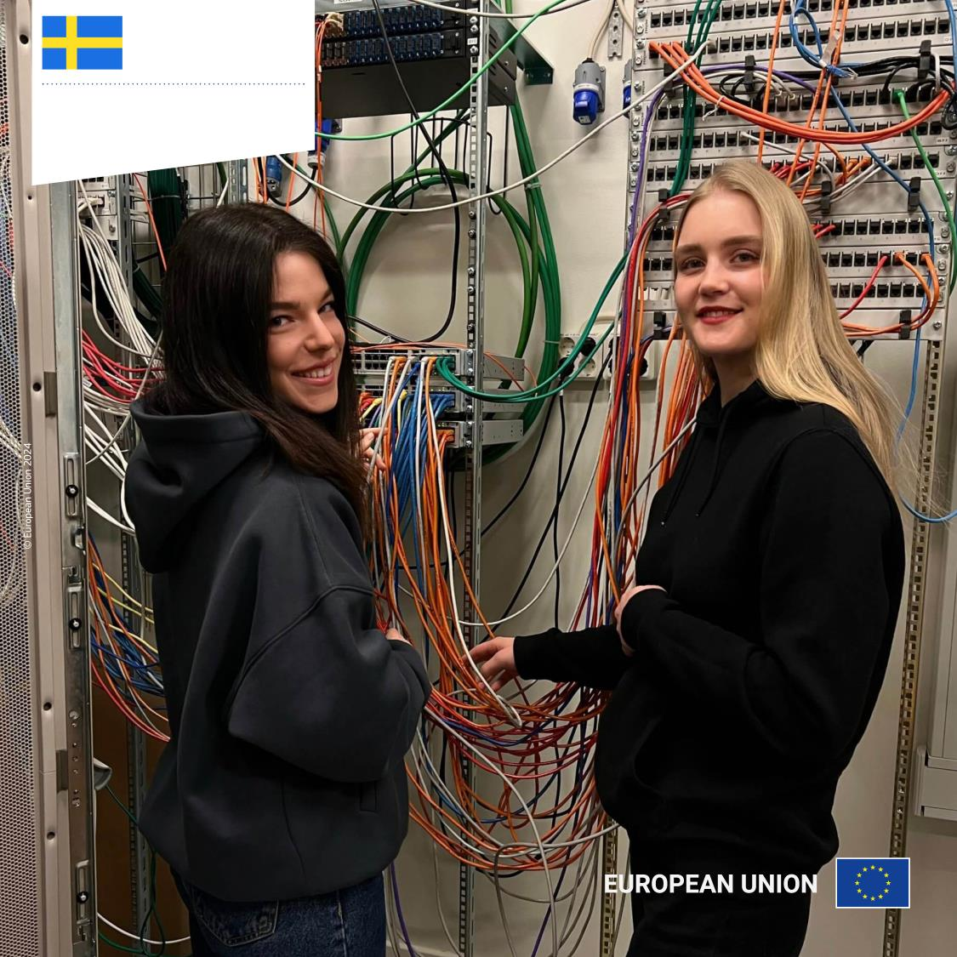
Sweden
Learning Mobility of Individuals
Empowering Ukrainian students through
double degree

Slide 13
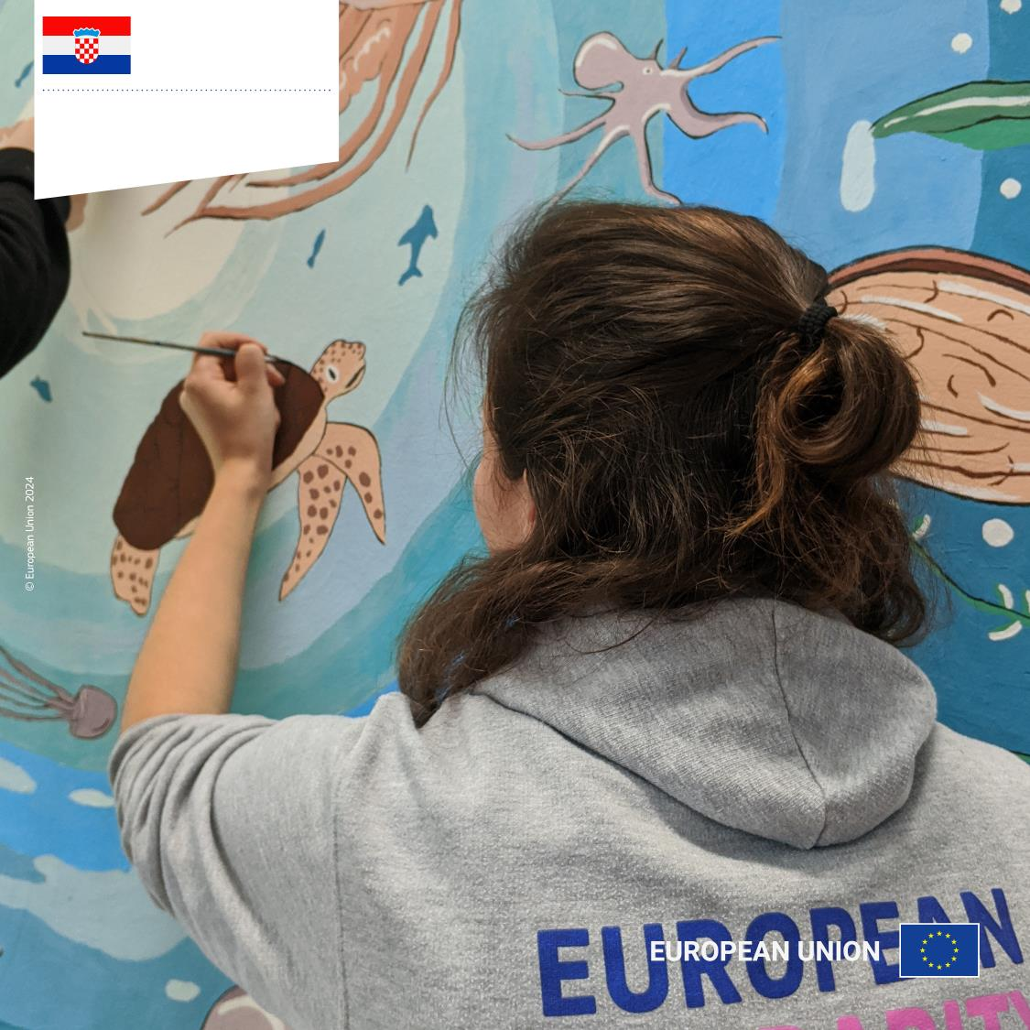
Croatia
Promoting sustainable awareness and environmental knowledge
Solidarity for
Green Dalmatia 2021

Slide 14
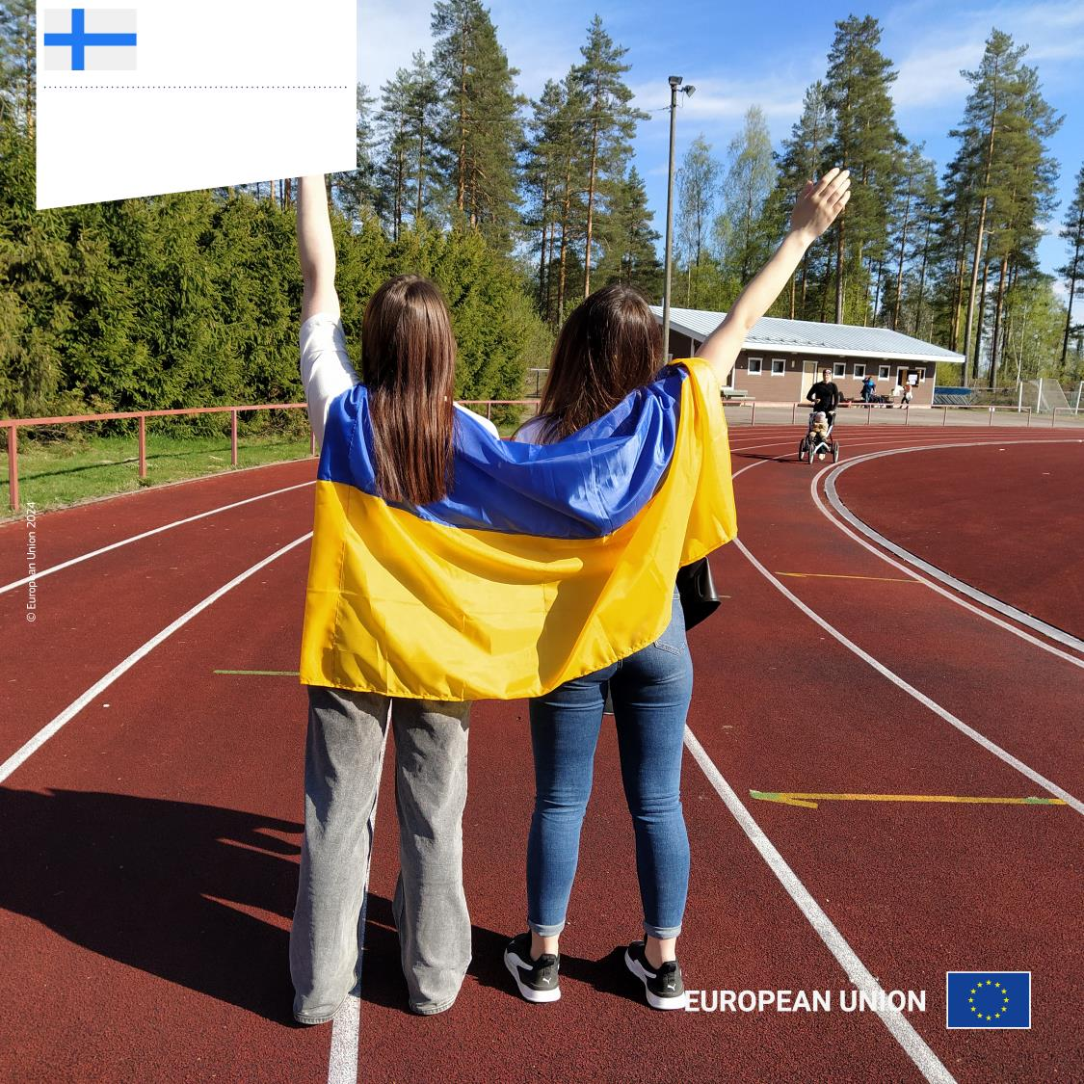
Finland
Bringing hope: young Ukrainian volunteers make a difference
European Messengers for Youth Empowerment and Communal Well being

Slide 15
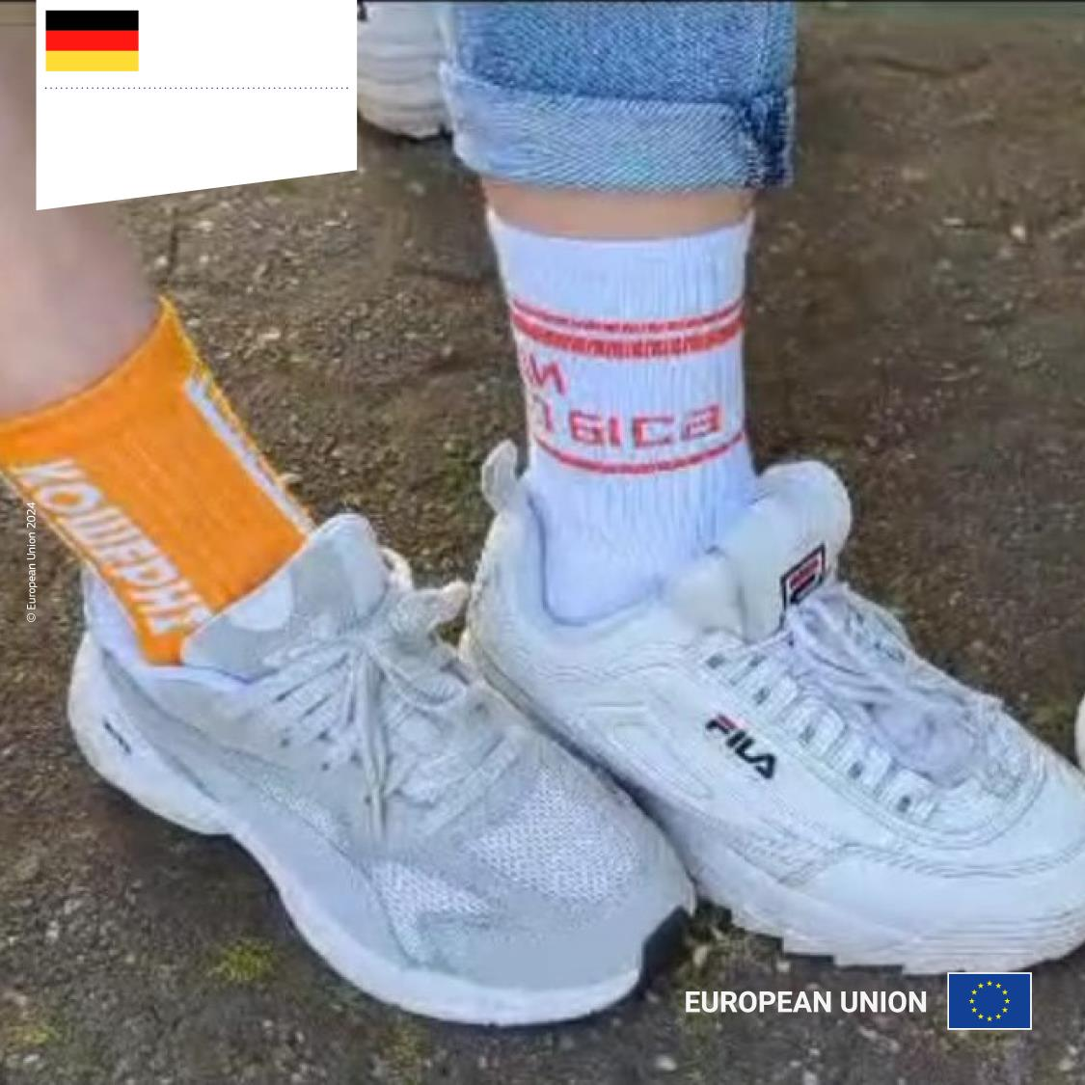
Germany
Connecting Ukrainian and local youth in Bremen
I Show You My City

Slide 16
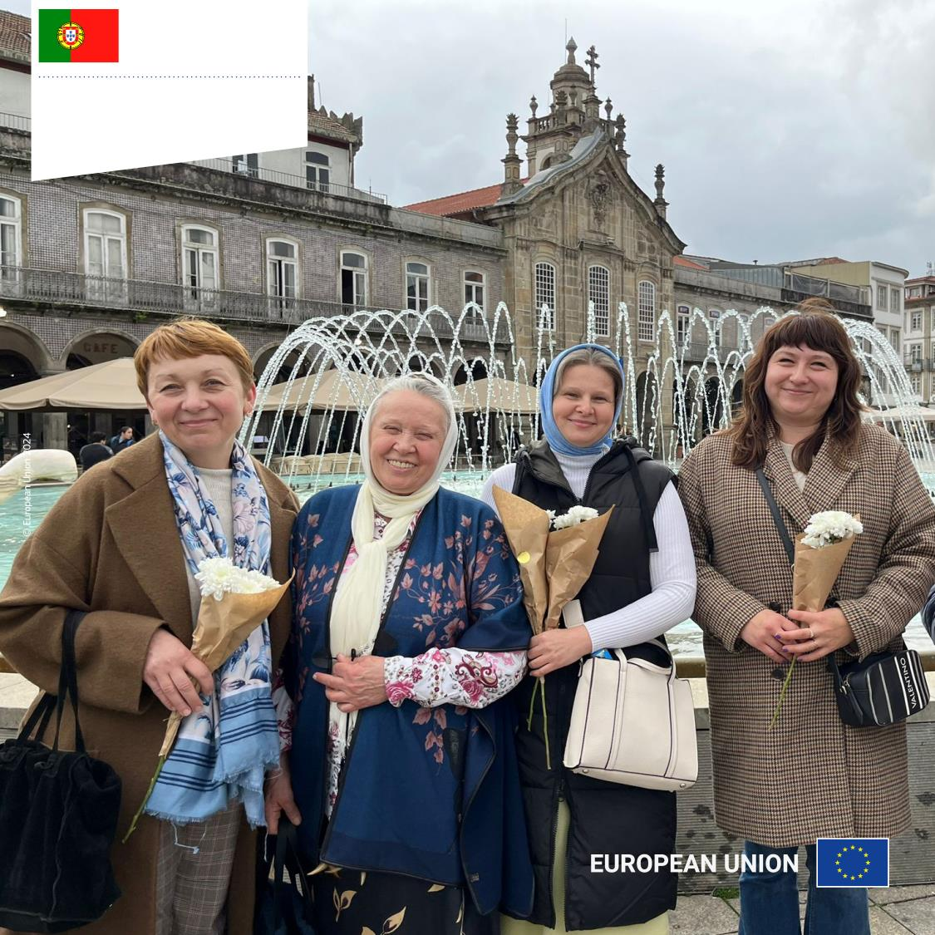
Portugal
Promoting inclusion of Ukrainian refugees in Braga
We Are Neighbours

